Slide 1
CPS 4982 –Big Data Analytics
Course Overview and Introduction
Dr. Changjiang Zhang

Slide 2
Instructor Info
Teacher: Changjiang Zhang
  Office: GHK C239
  Email: chazhang@wku.edu.cn
Find us through Email or come to my office during the office hours.

Slide 3
Hours for Section W01
Lectures:
  Mon. 10:00-11:15
Wed. 10:00-11:15

Slide 4
What do we learn in this course
Big Data Processing Basics (1 week)
  What is big data?
  How do we deal with big data?
Linux Operating System Basics (2 weeks)
  What is an operating system?
  Linux basic commands
Cloud Computing Basics (2 weeks)
  What is cloud computing?
  Why is cloud computing useful?
  How to use cloud computing?
  Docker
Hadoop and Spark (7 weeks)
  Distributed Computing and Hadoop basics
  HDFS
  MAP/REDUCE parallel computing/programming
  HBASE
  SPARK
Data-Parallel Analytics project with Hadoop/Spark (2 weeks)

Slide 5
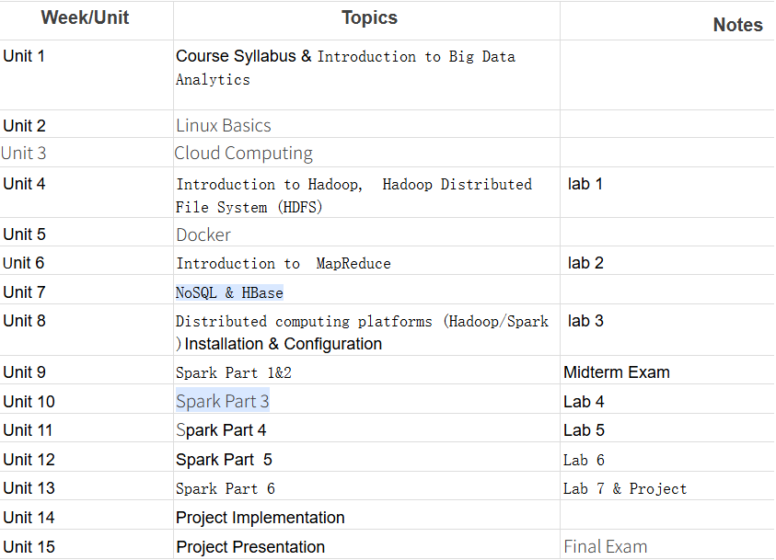
Course Schedule

Slide 6
Course Schedule
Topic | Schedule
Introduction | Week 1
Cloud & Linux | Week 2-3
Docker | Week 4
Hadoop & HDFS | Week 5-6
Spark Cluster | Week 7-8
Spark Word Count | Week 9
Spark Inverted Index | Week 10
Spark TF-IDF | Week 11-12
Project | Week 13-14

Slide 7
How do we learn in this course
Some lectures
A lot of hands-on practice or lab assignments

Slide 8
Methods of Evaluation
WKU
Class Attendance 5%
Labs 25%
Project 20%
Midterm 25%
Final Exam 25%

Slide 9
References
Tom White, Hadoop The Definitive Guide, 4th ed.
Sameer Wadkar, Jason Venner, etc. Pro Apache Hadoop, 2nd ed.
William Shotts, The Linux Command Line, 5th Internet ed.
Nigel Poulton, Docker Deep Dive, 2020 Ed
Wenqiang Feng, Learning Apache Spark with Python, Sept. 2019
http://hadoop.apache.org/
http://spark.apache.org/docs/latest/
http://spark.apache.org/docs/latest/sql-programming-guide.html

Slide 10
Assignment
Install VirtualBox and Ubuntu 20.4 on your laptop

